Slide 1

Host: Itunu
ZOOM MEETING ID: 819 6908 3399
Passcode: 250342
TIME: EVERY SATURDAY, 11AM EST (5PM LAGOS)

Slide 2

1 Thess 2: 2, 4
We are bold to declare the good news in inspite of oppositions We speak as messagers approved by God

Slide 3

Read a minimum of a chapter a day in the Bible
Pray 15 minutes every day
Plans for the year

Slide 4
FIRST THESSALONIANS CHAPTER 3

Slide 5

Paul sent Timothy when he could not go vs 1
Timothy to strengthen and encourage their faith vs 2
Troubles could distract ones focus from God vs3
The Thessalonians were advised of the pending troubles vs 5
The tempter could get the best of people

Slide 6
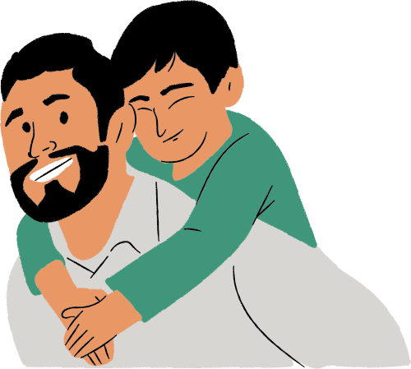
Timothy returned with good news vs 7
The Thessalonians remained strong in Faith
The Thessalonians stood firm in the Lord that gives new life vs 8
The well being of other believers should produce Joy vs 9

Slide 7

Paul prays to see the Thessalonians vs10
Prayed that their love for one another will grow and overflow vs 12
God makes their heart strong and blameless

Slide 8

Got Questions?

